Slide 1
Machine Learning in Finance

Slide 2
Agenda
Introductions
What are we doing today?
Demo
Labs
Next Steps

Slide 3
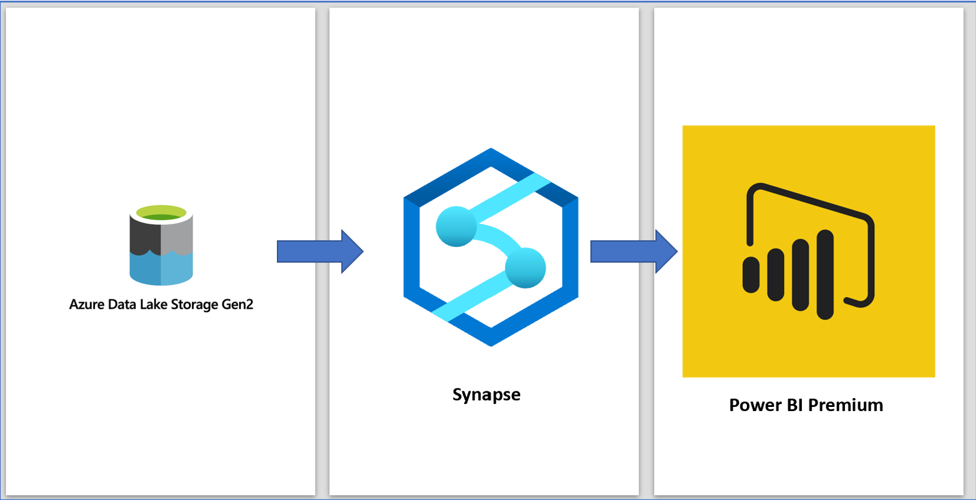
Architecture

Slide 4
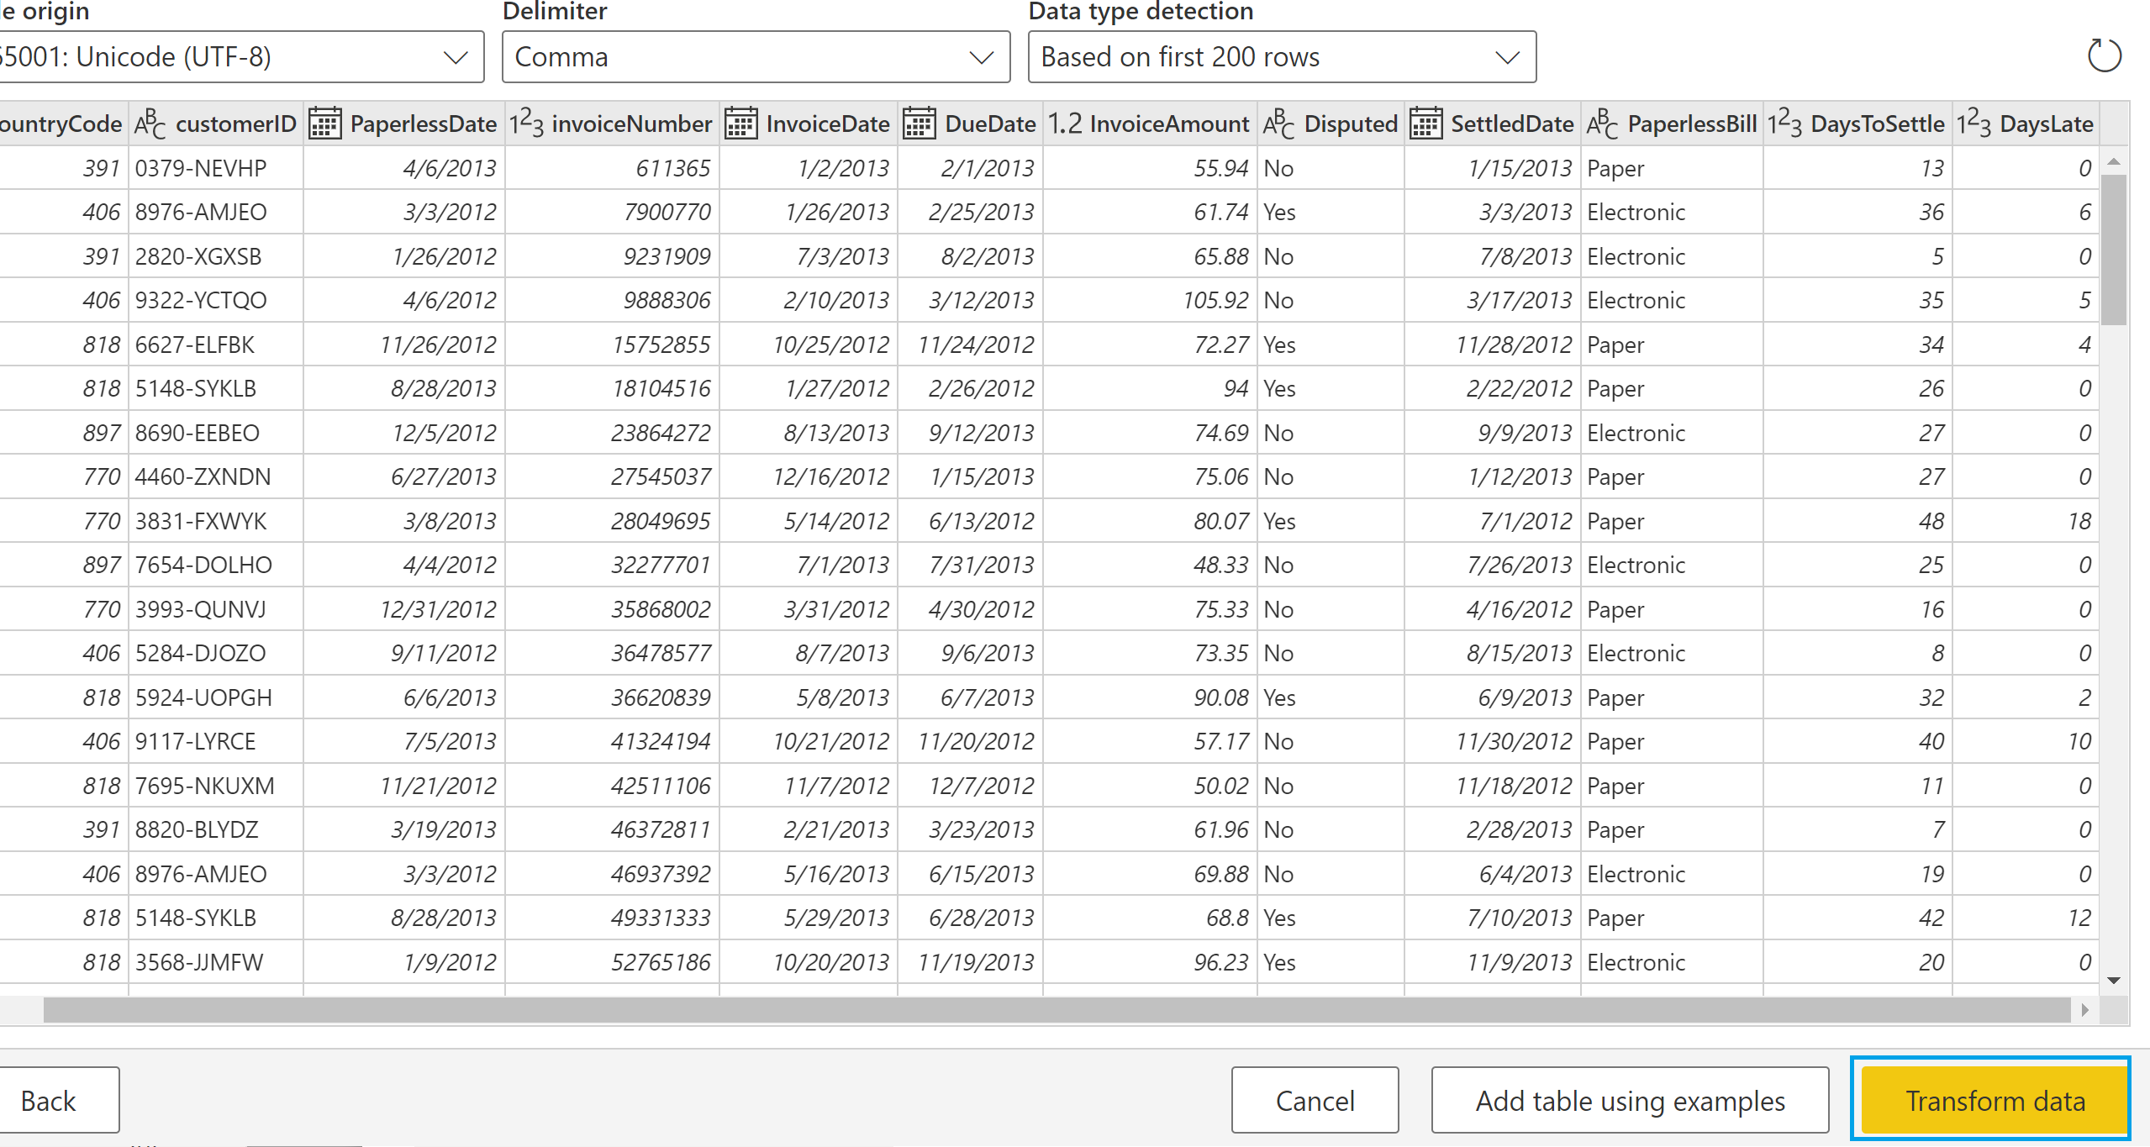
Raw Data

Slide 5
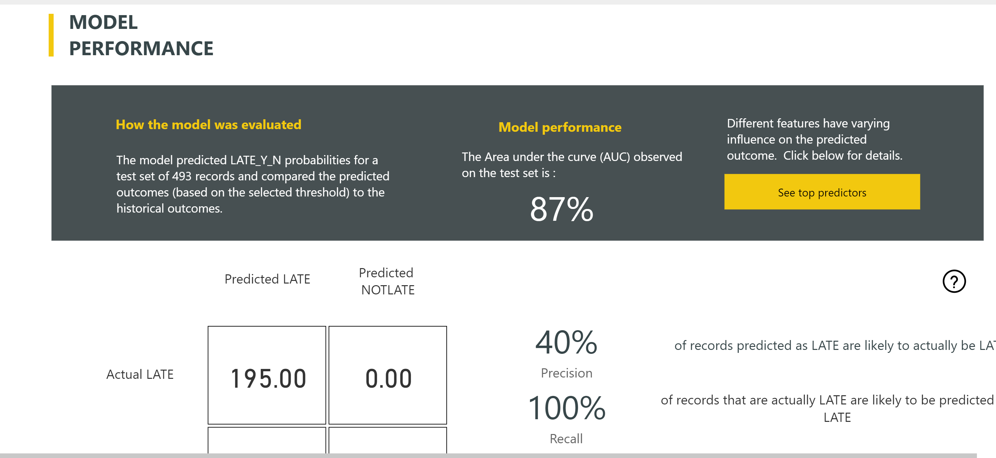
Navigate Machine Learning Model

Slide 6
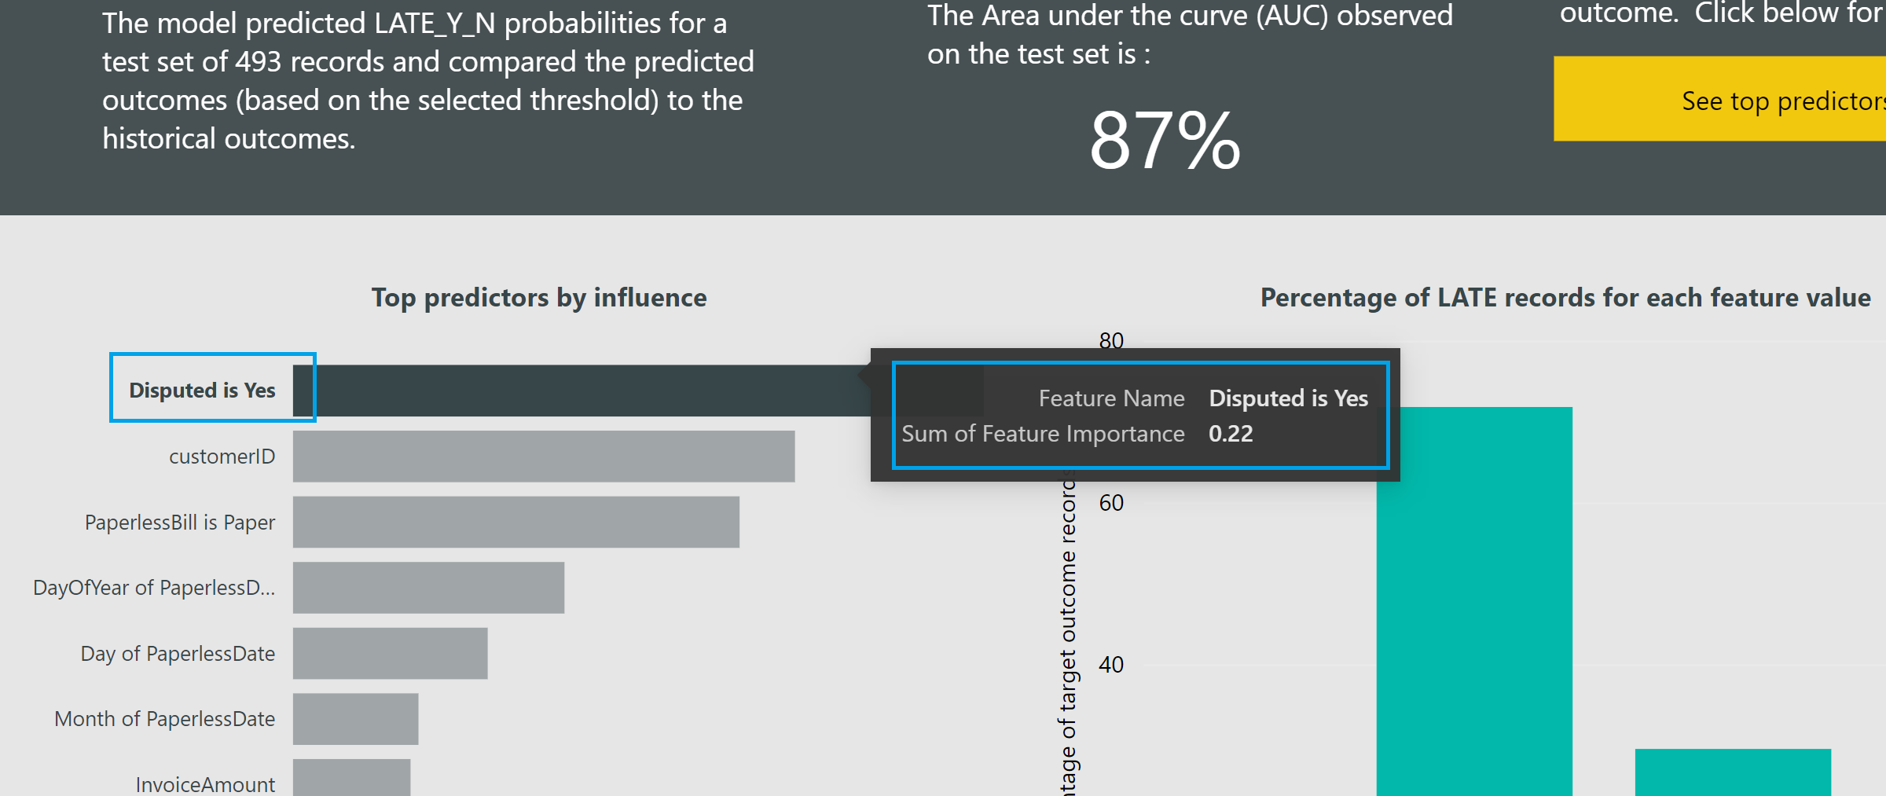
Navigate Machine Learning Model

Slide 7
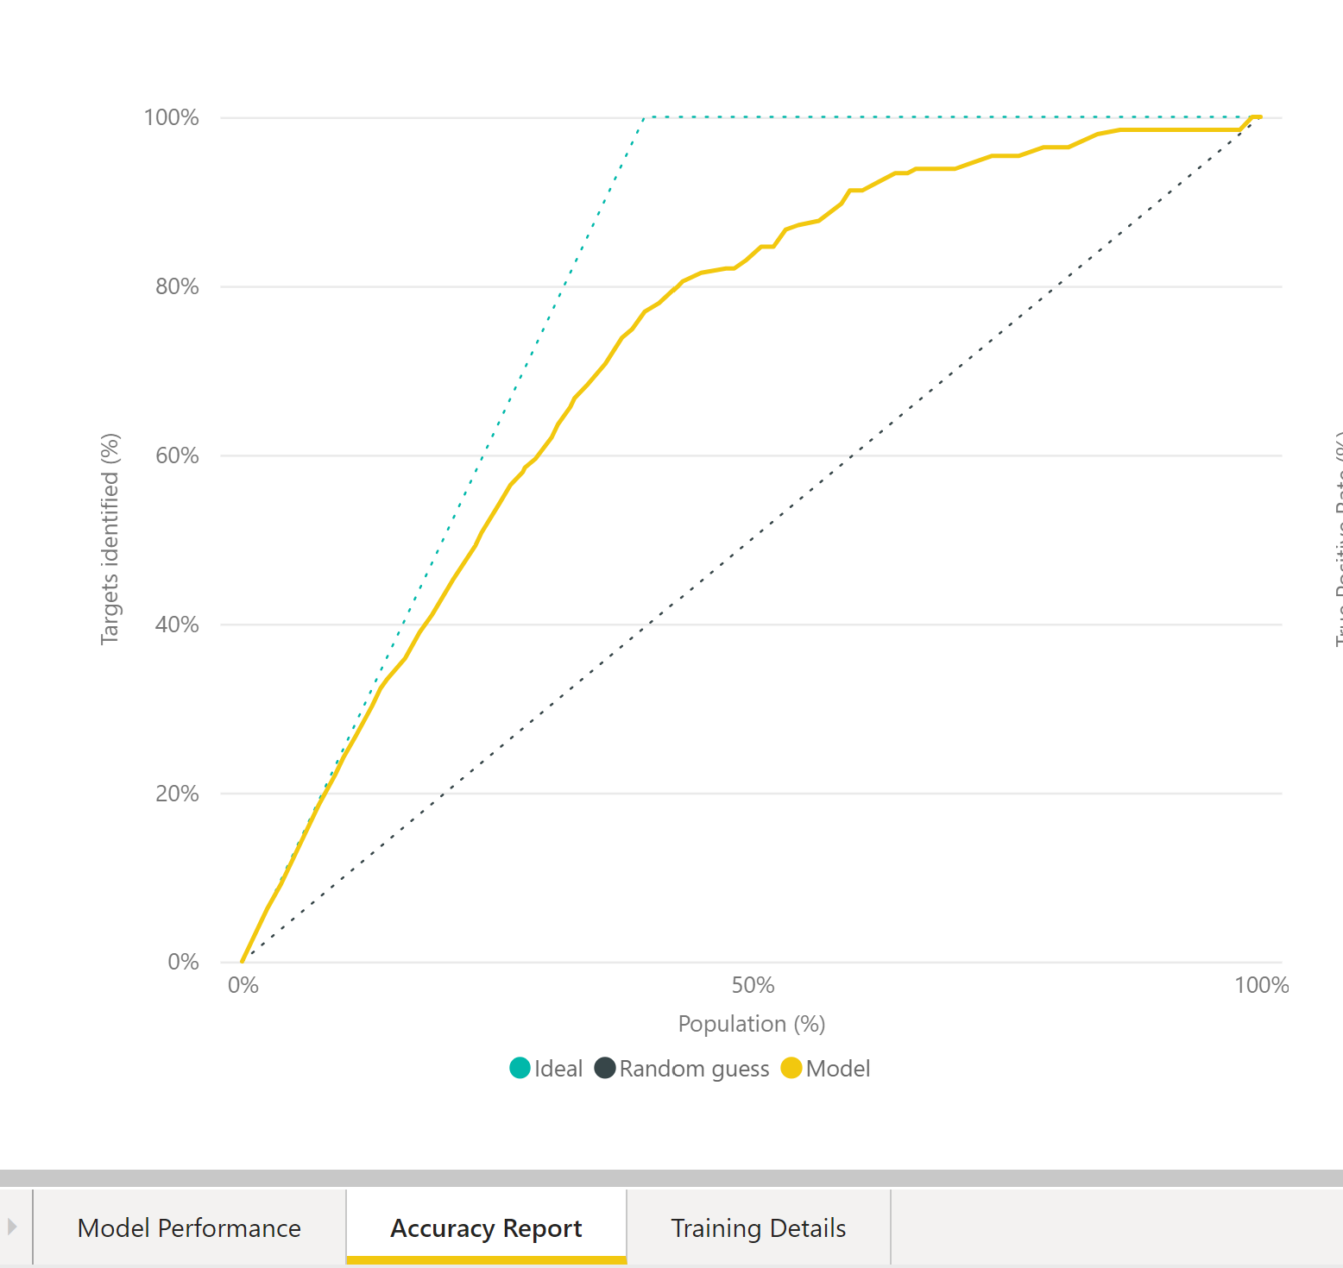
Navigate the ML Model

Slide 8
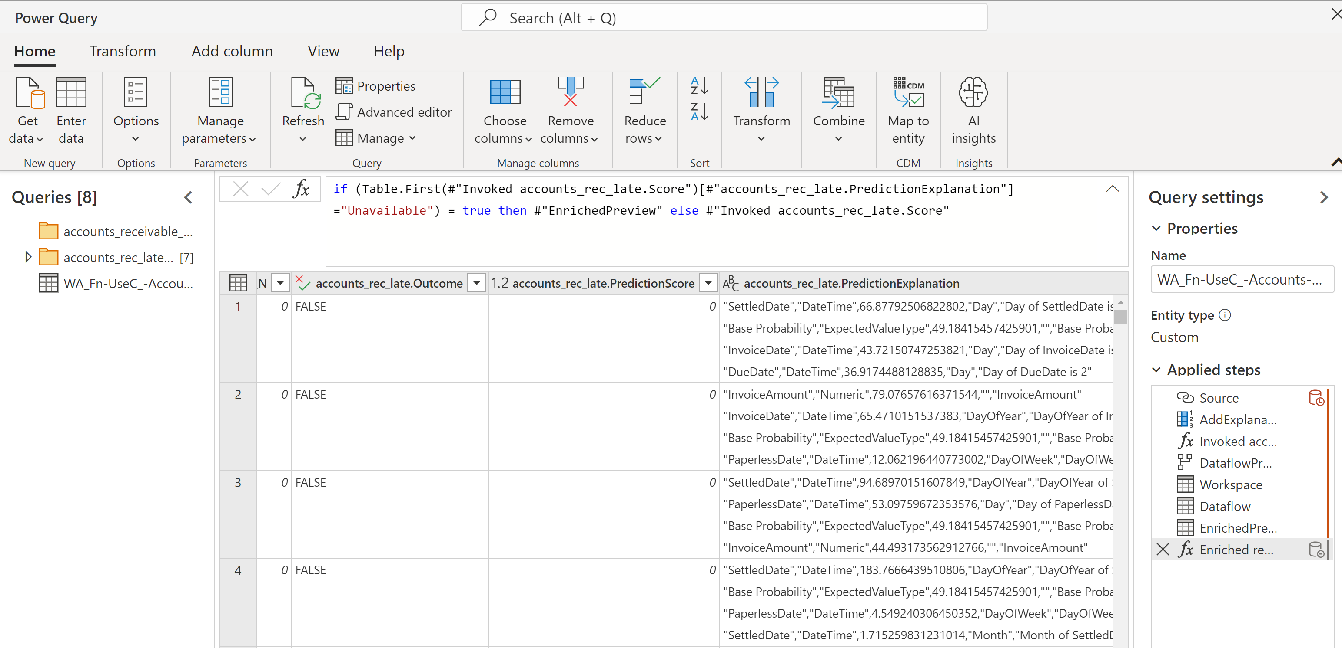
Invoke the Model

Slide 9
Student Lab – Github: https://github.com/iamjenetzler/pbifinanceml/tree/main/user%20files
Please provide feed back by clicking-> Feedback

